Slide 1
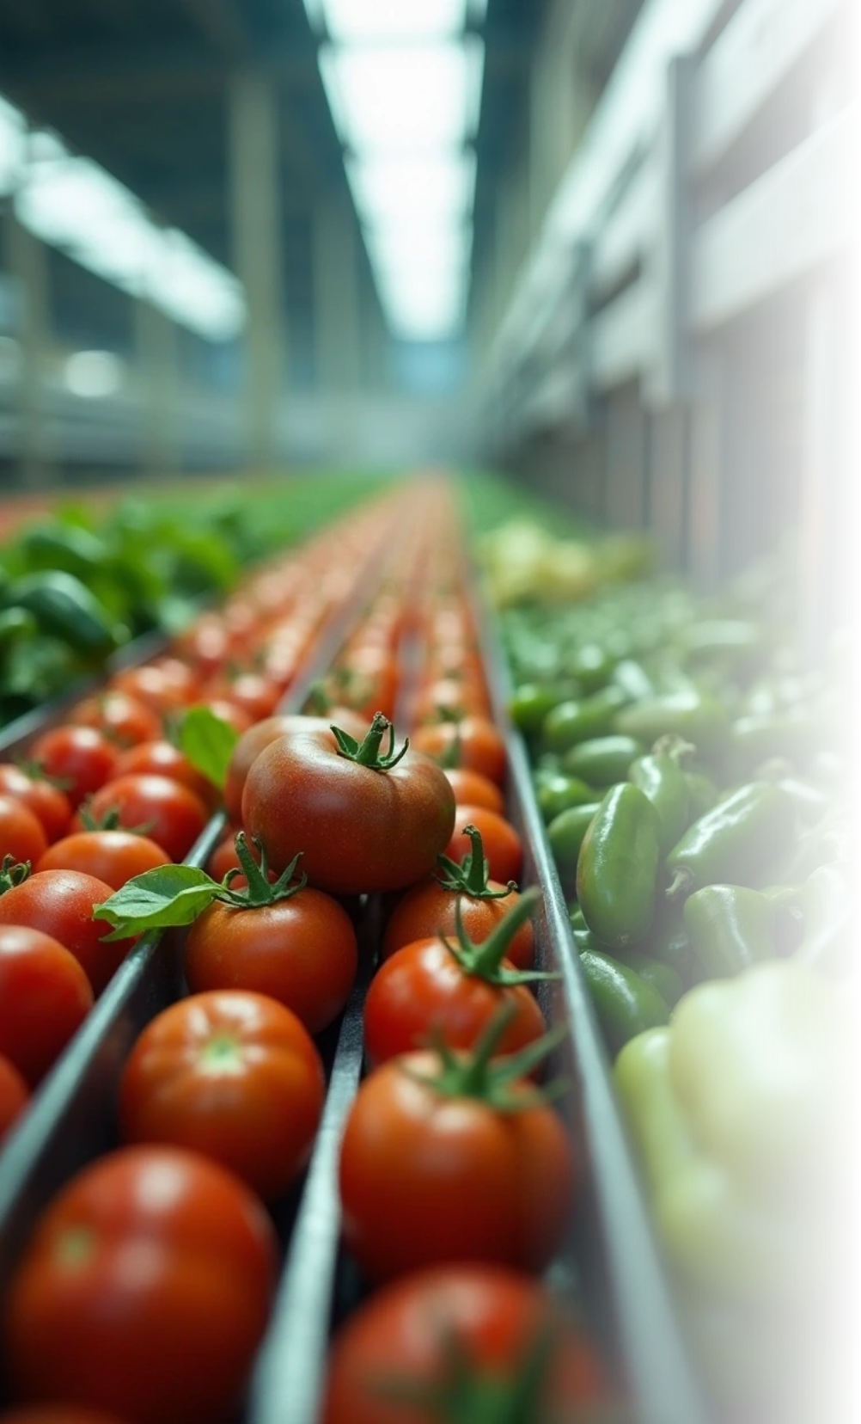

Smart Sorting Project
The Smart Sorting project utilizes transfer learning techniques to identify rotten fruits and vegetables. This innovative approach aims to enhance food quality control and reduce waste in agricultural supply chains.
Team Members:
Challa Madhav
Bommidi Yamini
Bobbili Lahya Priya
Boyina Jahnavi

Slide 2


Project Overview
1
Objective and Goals
2
Significance
3
Technological Approach
Develop an automated system to classify fresh produce as rotten or fresh.
Contributing to sustainable practices by reducing food waste.
Using transfer learning with pre-trained models for accuracy.

Slide 3




Transfer Learning Basics
Benefits
Definition
By using transfer learning, we can achieve higher accuracy with less data, making it an efficient method for our classification task.
Applications in Agriculture
Transfer learning involves taking a pre-trained model on a related task and fine-tuning it for a specific application, which saves time and resources in training.
This technique is particularly useful in agricultural settings, where labeled data may be scarce or expensive to obtain.
2
1
3

Slide 4

Methodology Overview
This methodology outlines the systematic approach we are taking to classify fresh and rotten fruits and vegetables. It details our data collection efforts, the models we will evaluate, and our training process to enhance accuracy.
Data Collection
Gathering images of various fruits and vegetables
Model Selection
Evaluating pre-trained models like VGG16, ResNet, and Inception
Training Process
Fine-tuning the model to improve recognition accuracy

Slide 5

Results and Findings
1
Accuracy Metrics
2
Comparison with Traditional Methods
3
Real-World Applications
The model's performance will be measured using accuracy, precision, recall, and F1-score to ensure reliable classification results.
Results will be compared against traditional methods of fruit and vegetable classification to highlight improvements in efficiency and accuracy.
Successful implementation can lead to automated sorting systems in warehouses and retail, enhancing overall food quality management.

Slide 6





Challenges and Limitations
Environmental Factors
Variations in lighting, backgrounds, and fruit conditions in real-world scenarios can affect the model's accuracy, necessitating robust training.
2
Data Quality
The performance of the model heavily relies on the quality and diversity of the training dataset; insufficient or biased data can lead to poor results.
1
Adaptability
The model may need further adjustments and training to adapt to different types of produce and varying conditions encountered in different regions.
3

Slide 7



Future Work
Expand Dataset
Real-Time Processing
Integration with IoT
Collecting more diverse images from different geographical locations and seasons to enhance the model's robustness and generalization.
Implementing the model in real-time systems for immediate decision-making in sorting and processing lines.
Exploring integration with IoT devices for automated monitoring and sorting processes in agricultural supply chains.

Slide 8

Conclusion
Impact on Food Waste
Advancements in Technology
Call to Action
The Smart Sorting project has the potential to significantly reduce food waste and improve the efficiency of food distribution systems.
By applying transfer learning, we can leverage cutting-edge technology to solve pressing agricultural issues.
Collaboration with agricultural stakeholders is essential to refine the system and implement it effectively in real-world applications.

Slide 9


THANK YOU
Thank You

